Slide 1


Homeless Initiatives City of Surprise, AZ
February 4, 2026
Adam Lane
Housing & Community Services Manager
City of Surprise, AZ

Slide 2
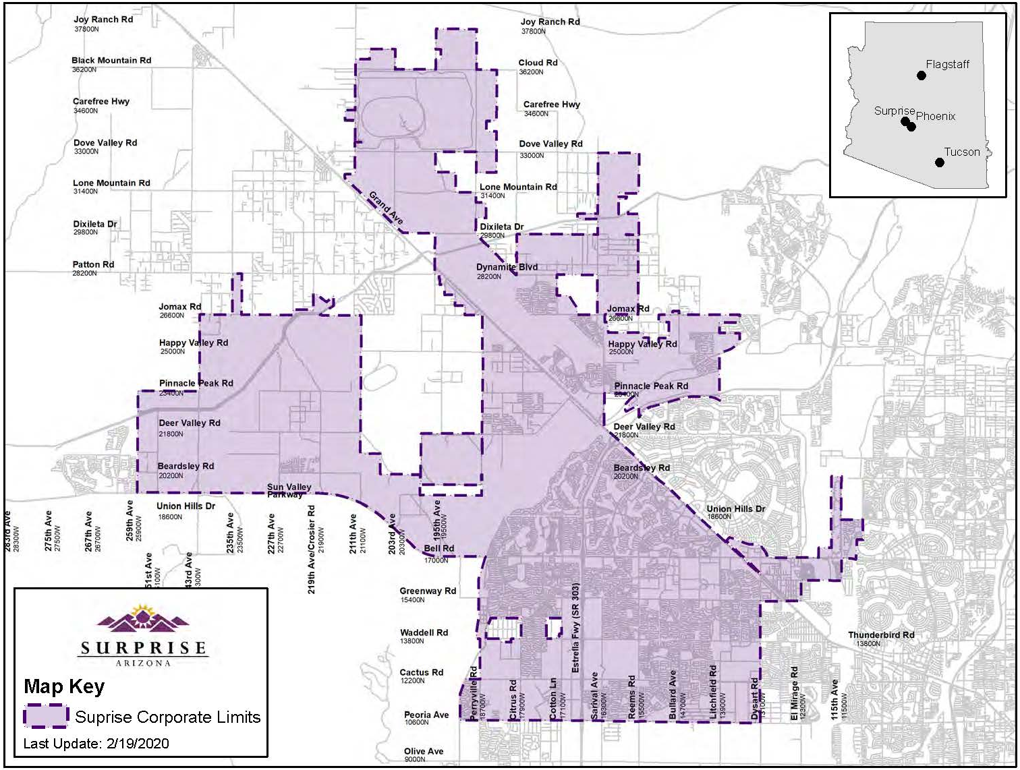
About Surprise
Population = 176,000 (2025)
Median Income: $93,371
56,632 Households
Room to grow
PY2025 Allocation: $748,125
HOME PY2025: $207,645
(Consortium)

Slide 3
Emerging Trends (2019)
Housing Affordability
83% of Surprise low-income renters severely cost burdened
42% of all renters were cost burdened
The region had the fastest growing rental rates in the country
Lack of available housing units; current supply vs. demand issue
Unbalanced housing stock – 85% SFD
80% homeownership rate
Need for multi-family housing
Growing Need:
In general Surprise experienced a relatively low population of people experiencing homelessness
100% increase in residents reported in HMIS
Surprise PIT Count 86% increase
The number of unsheltered homeless in the west valley increased 213% in FY20
No Shelter beds in the NW Valley

Slide 4
What is the Goal?
Access to safe and affordable housing for all residents
End Functional Homelessness
A functional end to homelessness means no person remains homeless longer than 30 days prior to moving into permanent housing.
Diversion/ Prevention
Services
Shelter
Housing
Coordination
Keep People Housed
Regional Collaboration
Expand & Improve Access
Add Shelter Capacity
Increase Affordable Housing

Slide 5
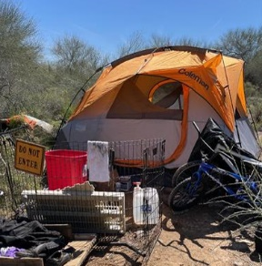
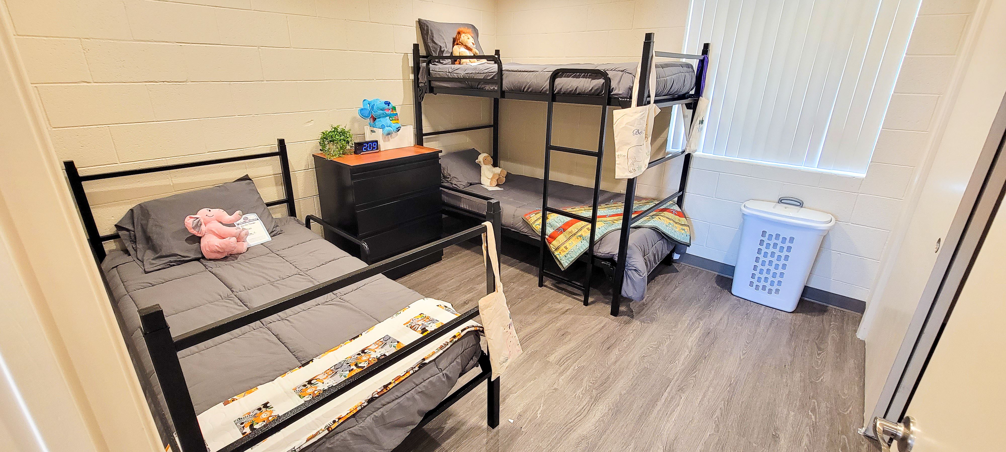

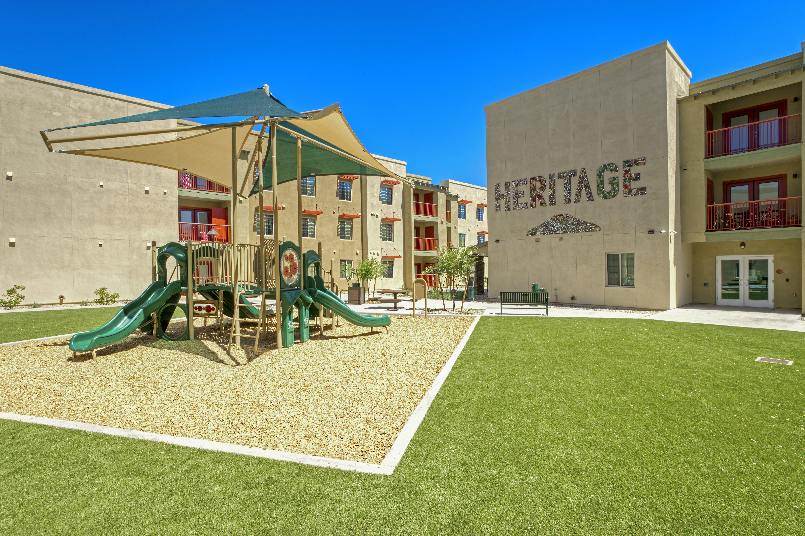
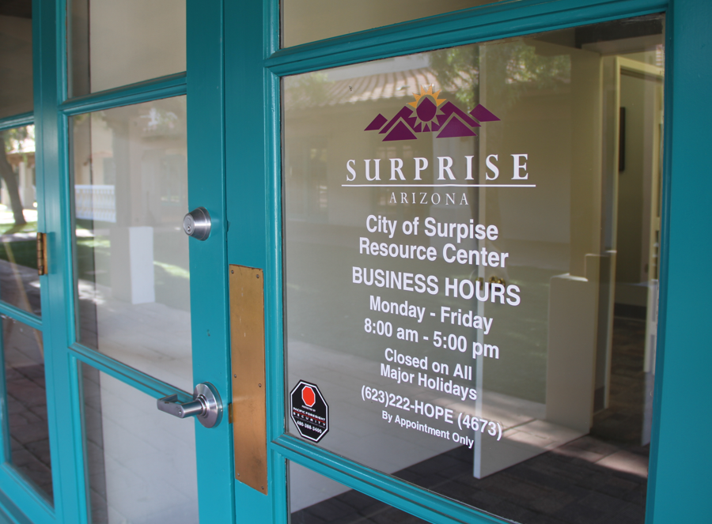
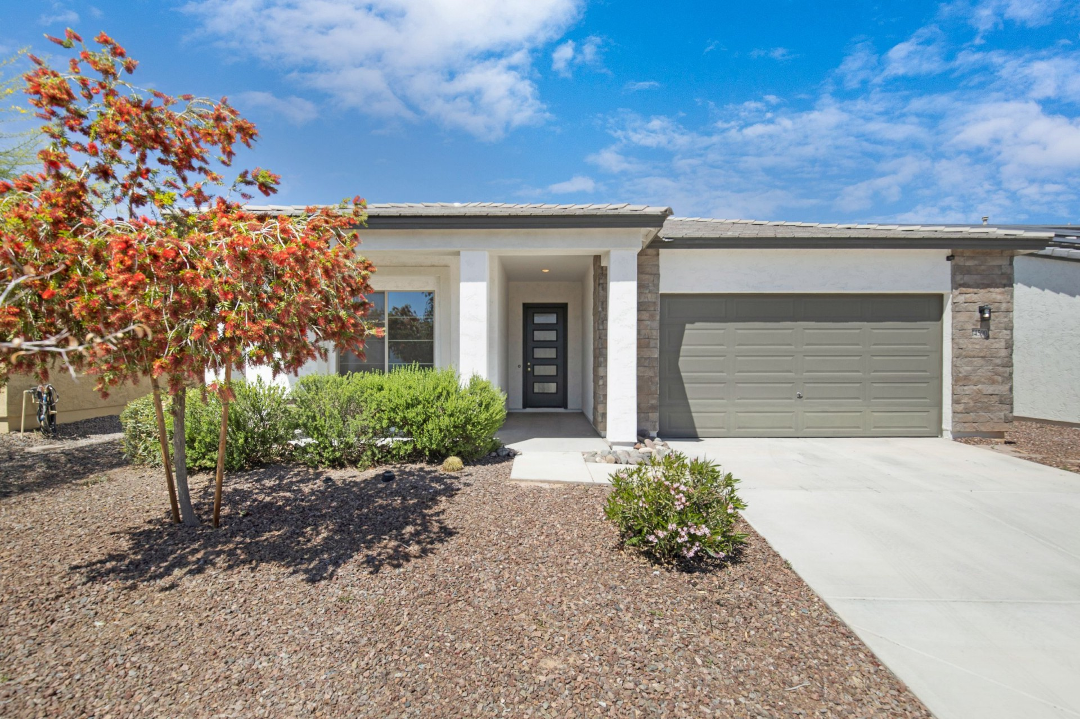
Housing Solutions
Homeless Engagement
Temporary Shelter
Interim Housing
Permanent Housing
Housing Stability
Homeownership
TBRA
Heritage at Surprise
Surprise Resource Center
Home Rehabilitation

Slide 6
More Trends
Access to Resources
Where can people go to get housing services?;
Resources clustered in central valley (Phoenix);
Stimulus funding showed the need for centralized location of resources
The nearest Coordinated Entry site is in Phoenix;
West Valley residents may have to travel 40+ miles to access services

Slide 7
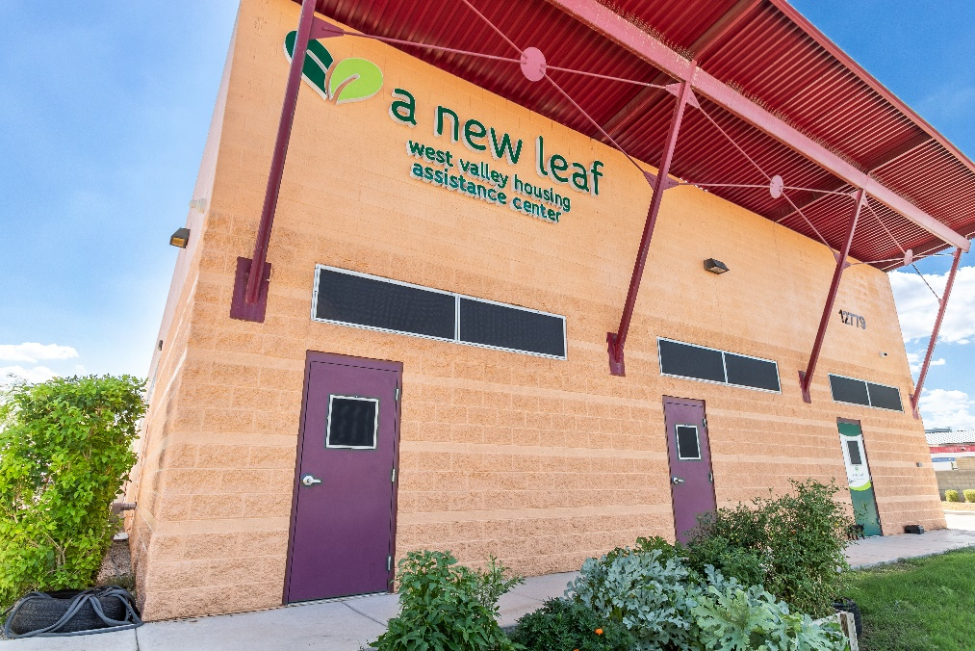

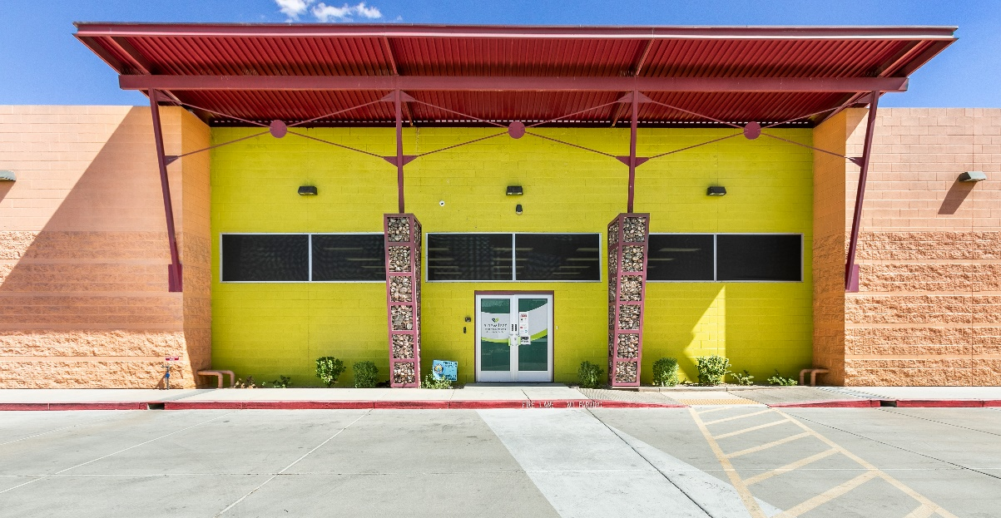
West Valley Housing Assistance Center

Slide 8
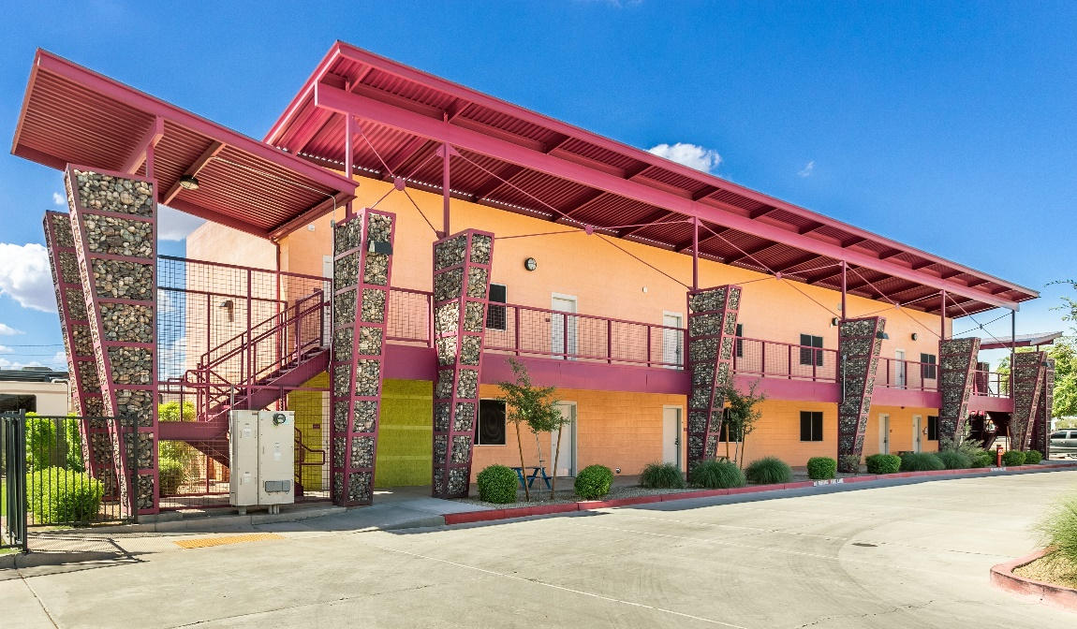
West Valley Housing Assistance Center
Seven apartment style housing units
Non-congregate shelter
for families
Centralized location of housing resources
Housing focused – provide resources and access to permanent housing

Slide 9
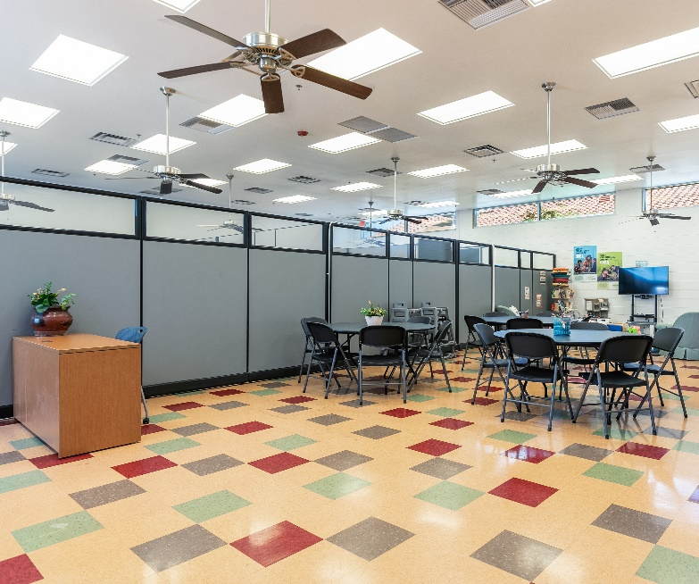
West Valley Housing Assistance Center
Families can stay up to 90 days
Case management and housing navigation
Residents receive 3 meals per day
Resources are available to anyone experiencing homelessness or at risk
Coordinated Entry Site
Diversion services
Case management
Educational resources
Financial assistance

Slide 10
West Valley Housing Assistance Center
Located in the West Valley of Maricopa County – 30 miles from downtown Phoenix
Access to housing resources and services out of reach for most in the West Valley
A small regional shelter was the catalyst for others to follow
New West Valley Partnerships:
Native American Connections
HomeBase Surprise
West Valley Homeless Collaborative
Hand-in-Hand Partnership
City of El Mirage
City of Glendale
City of Peoria
Maricopa County

Slide 11

Street Outreach
Phoenix Rescue Mission
Street Outreach & Engagement
Outreach and navigation for unsheltered persons
875 (FY25) Street Outreach Contacts
262 Client Navigation Engagements
34 individuals placed in shelter/housing
86 Diversion Services provided

Slide 12
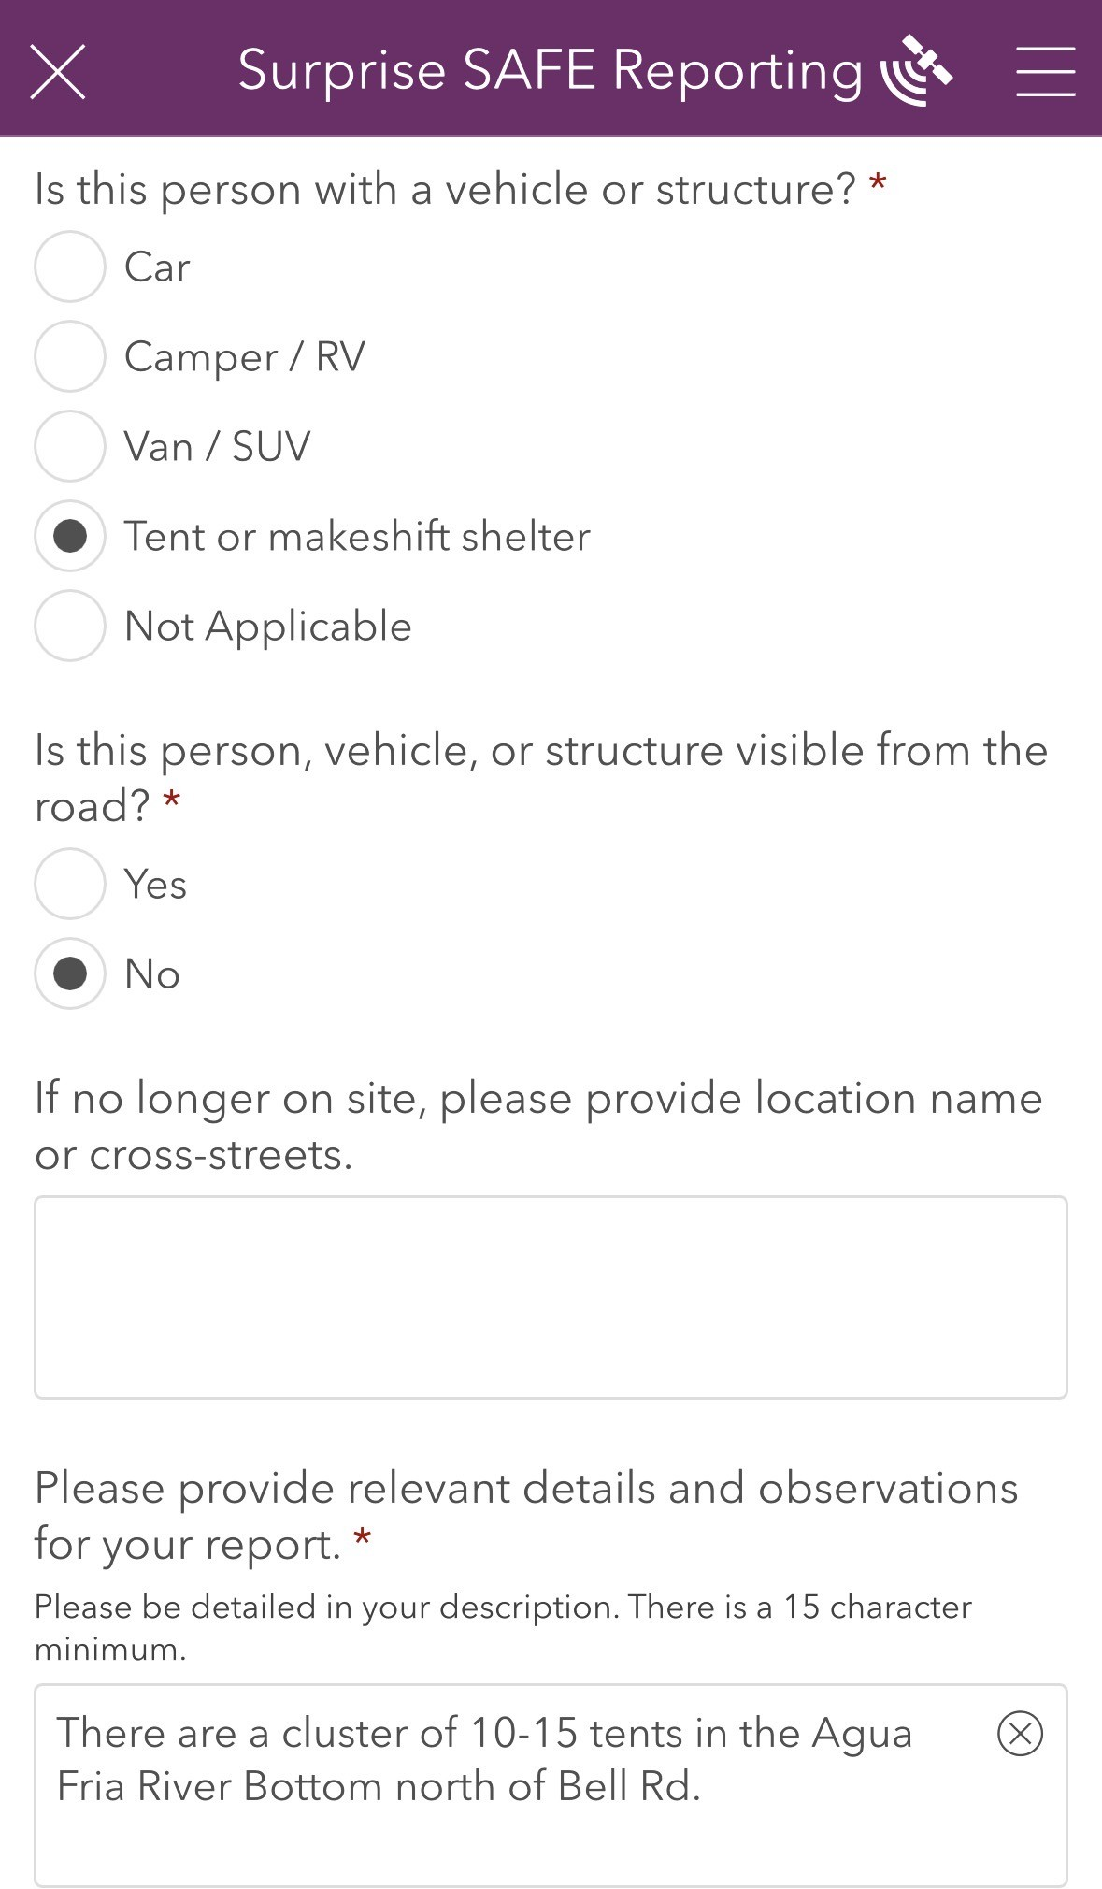
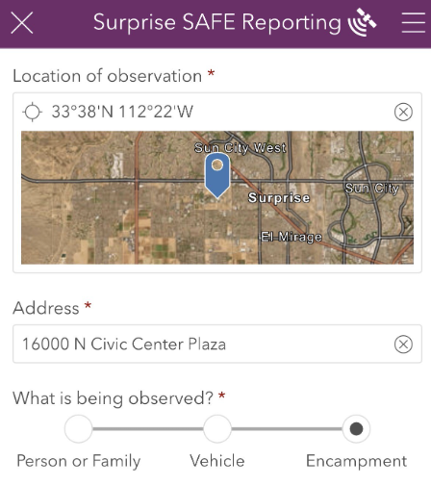
SAFE Reporting
In 2024, the City of Surprise released a mobile application enabling residents and partners to submit geo-located requests for homeless services.

Slide 13
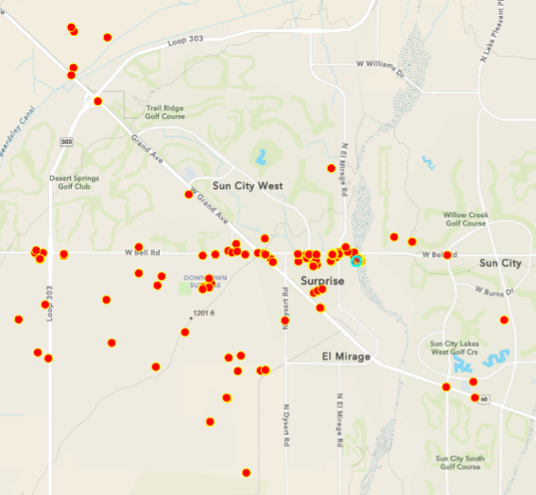
SAFE Reporting
Reports feed into a back-end system where staff review details and dispatch outreach teams for services.
Aggregate data is used to strategize ongoing homeless initiatives.

Slide 14
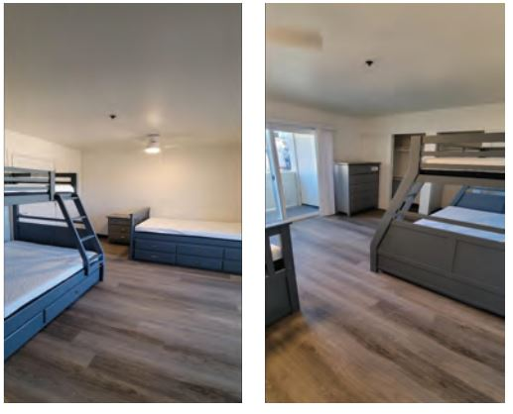

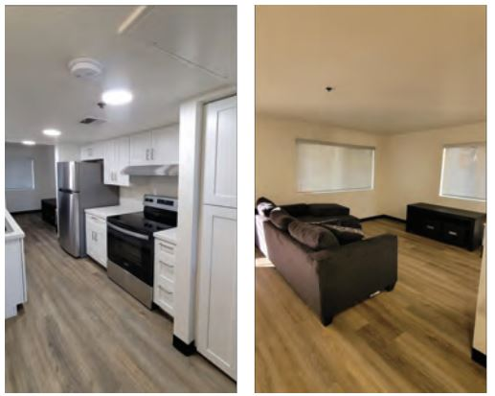
Bridge Housing
Native American Connections
Partnership with Maricopa County
9 - condo units
Owned and operated by NAC
Stays for 6 -24 months
Homeless families and individuals
Housing ready households
Continued case management
Housing navigation
Anticipated 48 persons assisted per year
CDBG Expended: $200,000
ARPA Expended: $1,900,000

Slide 15
Housing Solutions
Homeless Engagement
Temporary Shelter
Interim Housing
Permanent Housing
Housing Stability
Homeownership
Street Outreach
Diversion
Heat Relief
Flexible Funding
Coordinated Entry
WVHAC
Crosswinds Shelter
HomeBase Youth Shelter
Bridge Housing
Rapid Rehousing
TBRA
PSH - Crosswinds
Heritage at Surprise
Heritage Senior
WF Housing
Eviction Prevention
Benefit Enrollment
WF Development
Food Assistance
DPA Access
Housing Counseling
CLT
Home Rehab

Slide 16
Contact
Adam Lane
Housing & Community Services Manager
City of Surprise
Adam.lane@surpriseaz.gov

